Slide 1
Project 3: KitsuneCoin
Peter DiBona, Erik Larson, John Melvin, Pradeep Dahal and Alek Birkeland

Slide 2
Goals
01
Create/Mint token (KitsuneCoin) and Kitsune Game items
Create NFT DApp with a rewards based game component.
02
03
Allow users to generate NFTs
Users can go on “Quests” which bring in game rewards.
04

Slide 3
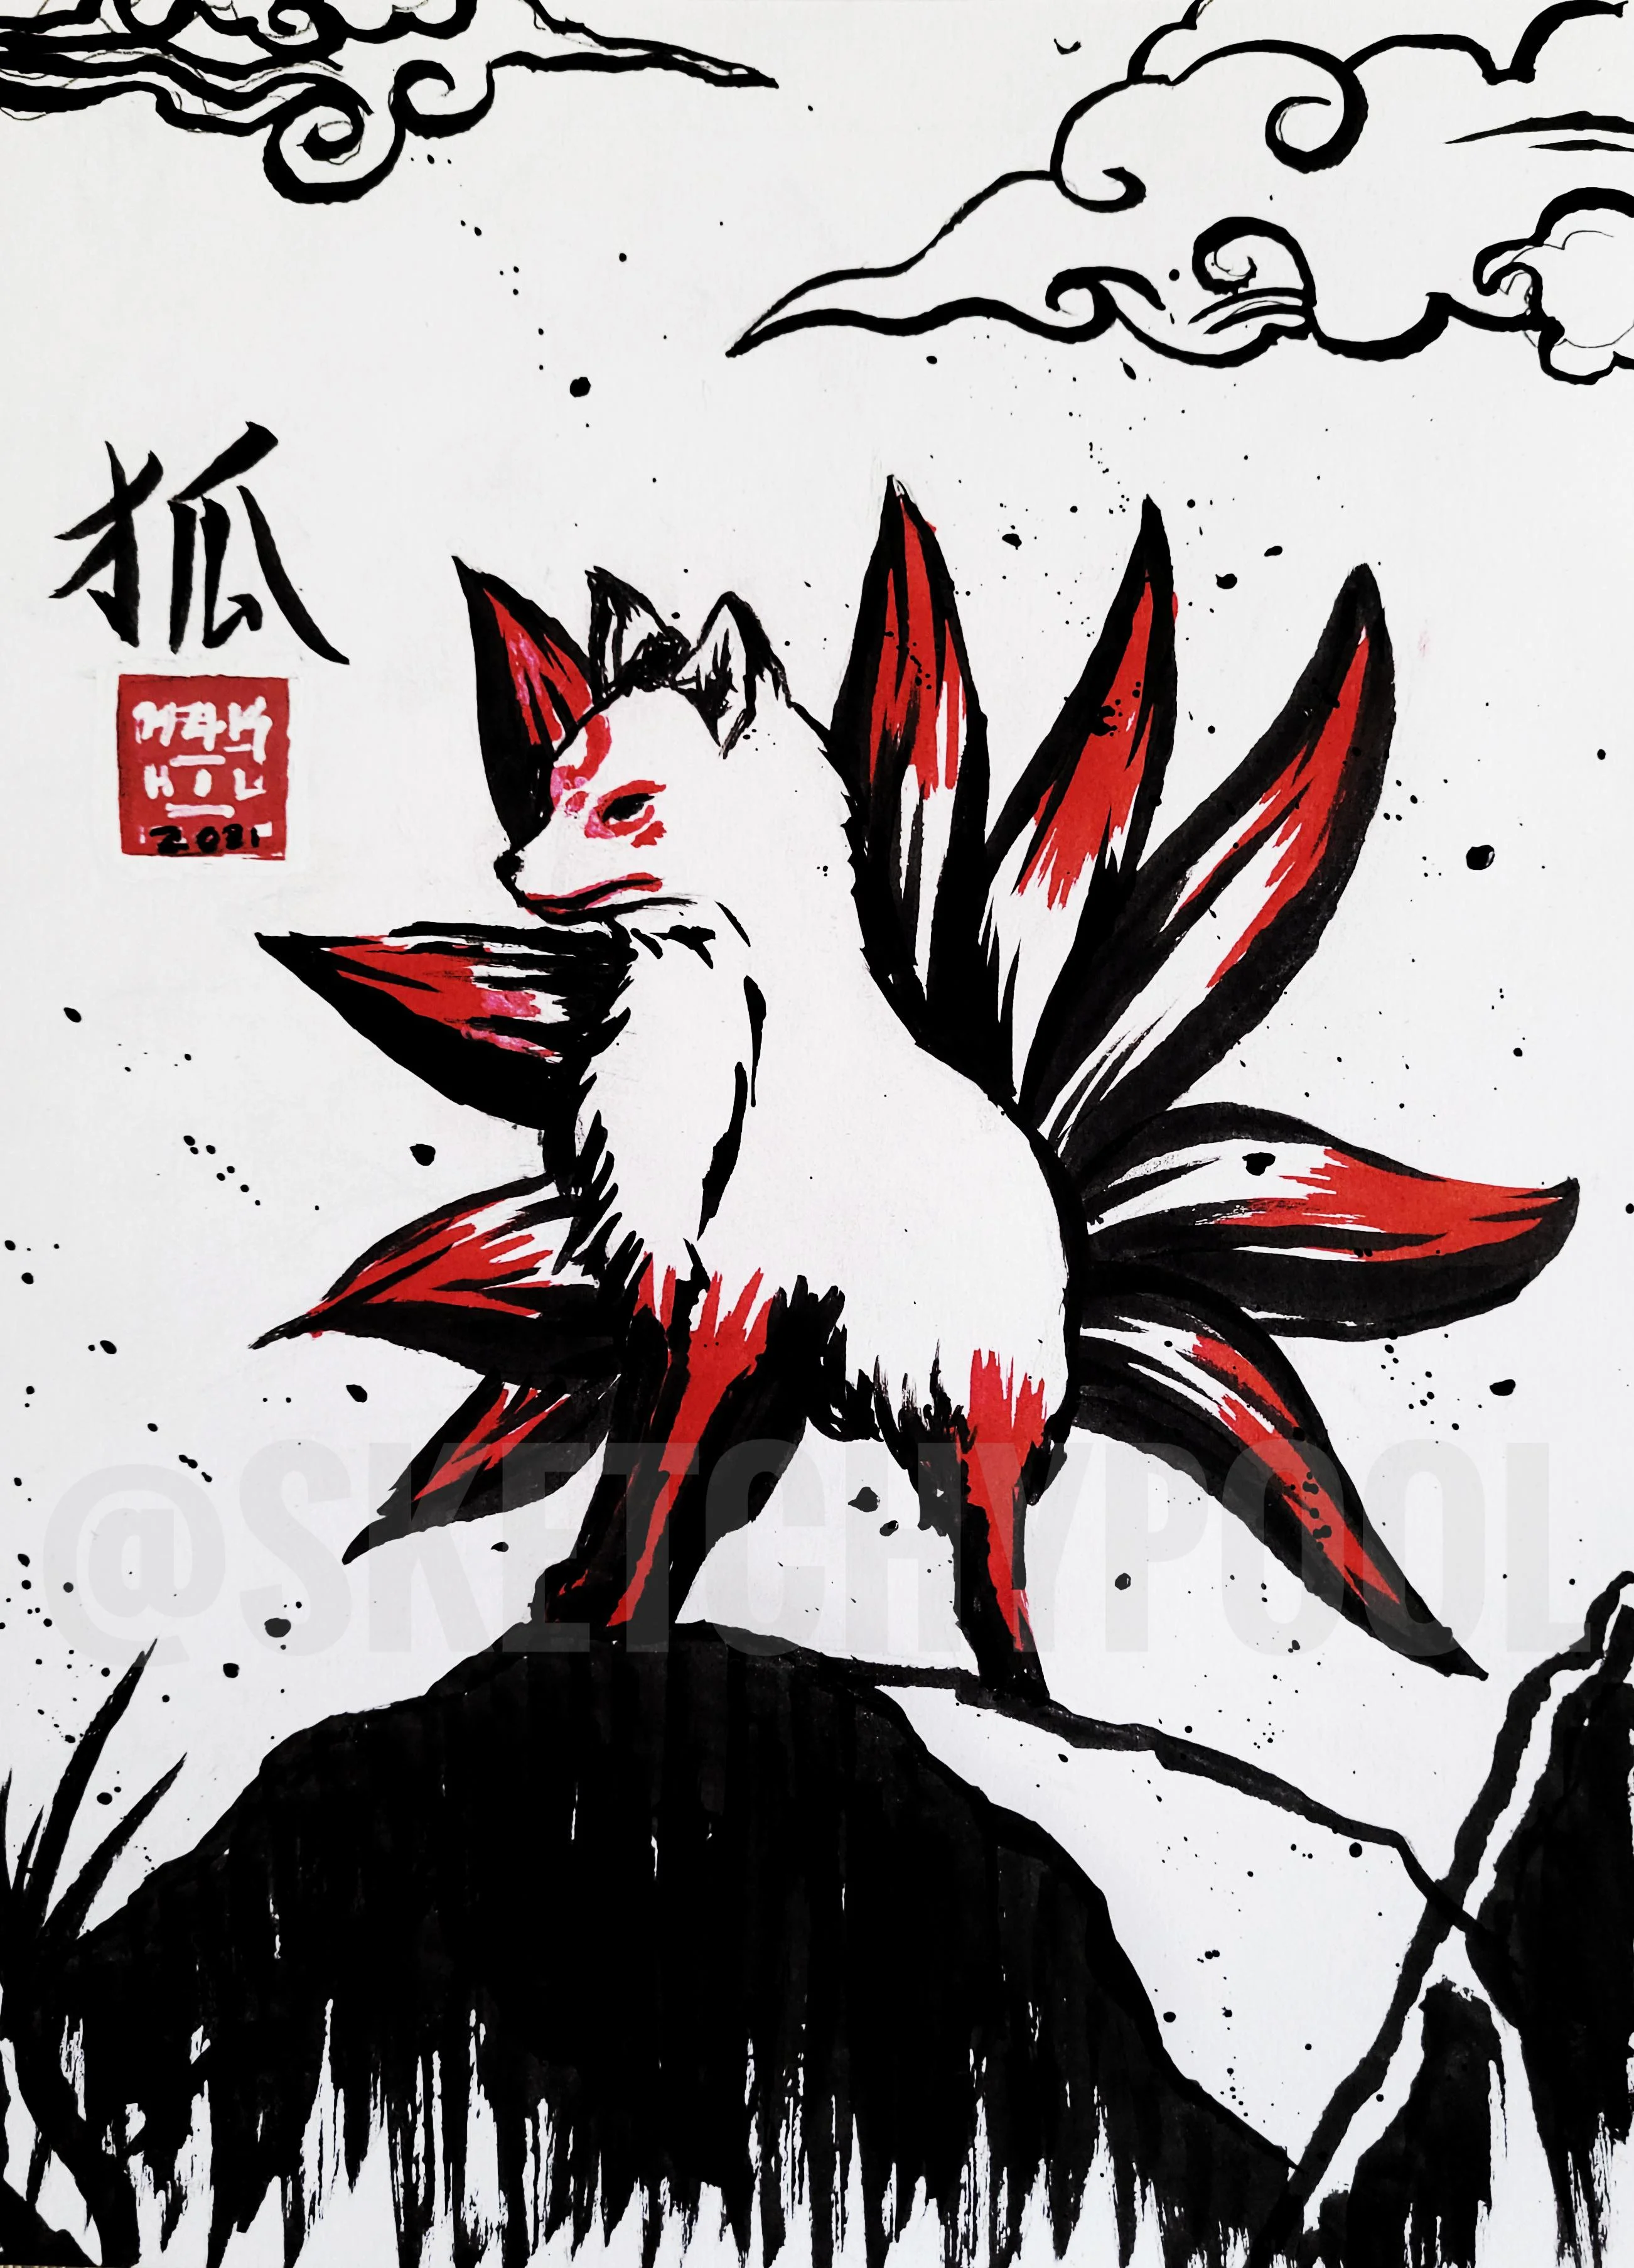
What is Kitsune?
In Japanese folklore, kitsune or foxes are depicted as intelligent and possessing magical abilities. Foxes were once thought to be messengers of the kami (divine being) Inari. It was believed that foxes could take on human form, usually the shape of a beautiful woman. However, they’re depicted as clever tricksters rather than evil monsters. The nine-tailed fox is a recurring theme in pop culture, as seen in the Pokemon and Naruto series as well as the critically-acclaimed Okami video game. The idea of nine-tailed foxes comes from China, where they were believed to be omens.

Slide 4
How is it related to Fintech?
Using BlockChain technology which is used in decentralized finance.
NFT’s would be part of a “game-fi” or “Play to earn” model.
Using Crowdsale.

Slide 5
Our Approach
Emulate something similar to “DeFi Kingdoms” on Harmony One Network.
Use Crowdsale to mint the Kitsune token.
Concentrated on building out ERC20, 721 and 1155. Focus on adding in-game items.

Slide 6
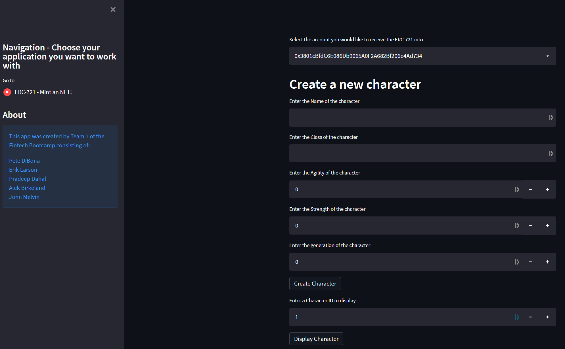
Screenshot from our Not working app

Slide 7
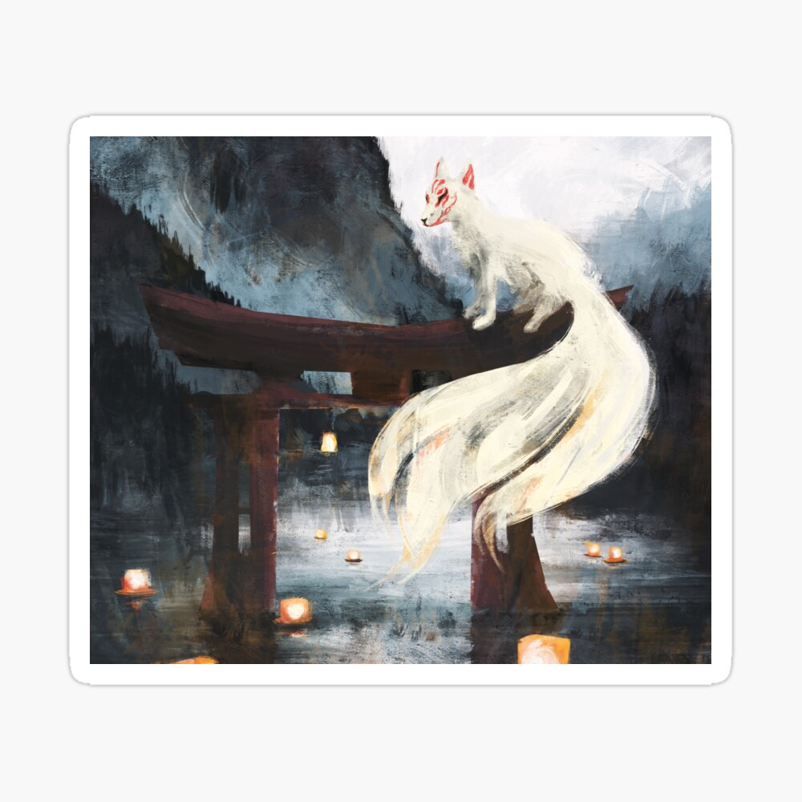
Results and Analysis
Ultimately we were not able to make our vision completely a reality.
We had major problems getting the Crowdsale to work properly.
We encountered several issues when using Streamlit.
We tried several ways to resolve the problems.
We were able to run original app without adding fancy libraries.

Slide 8
Next Steps?
Resolve Streamlit issues.
Build game/quest functionality.
Build burn functionality.
Print out the character ID properly.
Look into upgrade for Streamlit (Django, Flask)

Slide 9
Questions?

